Slide 1
Internship Presentation
PRESENTED BY Rasika NaVGHARE

Slide 2
Agenda:
Introduction
Project 1: Oil and Gas Analysis
Objectives
Methodology
Key Findings
Recommendations
Project 2: Supply Chain Shipment Analysis
Objectives
Methodology
Key Findings
Recommendations
Conclusion

Slide 3
Introduction
This presentation showcases two significant projects: An analysis of oil and gas well data and an optimization study for supply chain shipments. Both projects utilize advanced data analysis techniques to derive actionable insights.
Data analysis is crucial for identifying patterns, optimizing processes, and driving strategic decision-making in various industries.

Slide 4
Project 1: Oil and Gas Analysis
Objective:
To derive insights from oil and gas well data to optimize drilling operations and maximize gas production.
Tools Used:
Python, numpy, pandas, matplotlib, seaborn.
Dataset Overview:
The dataset contains detailed information on various wells, including their measured depth, rate of penetration (ROP), wellhead pressure (WHP), bottom hole pressure (BHP), Reservoir gas rate, and biozones.

Slide 5
Data Cleaning and Preprocessing
Handled missing values, converted data types, and filtered relevant columns for analysis.
Here are some code snippets for data cleaning
data = data.dropna()
# Convert data types
data['Measured Depth (ft)'] = pd.to_numeric(data['Measured Depth (ft)'], errors='coerce’)
data['Gas Rate (MMSCF/D)'] = pd.to_numeric(data['Gas Rate (MMSCF/D)'], errors='coerce’)
# Filter relevant columns
data = data[['Well', 'Leg', 'Biozone', 'Measured Depth (ft)', 'Gas Rate (MMSCF/D)']]

Slide 6
Exploratory Data Analysis (EDA):
Purpose:
EDA was performed to understand the distribution of data, identify patterns, and detect anomalies.
Key Techniques:
Histograms
Box plots
Scatter plots
Correlation heatmaps

Slide 7
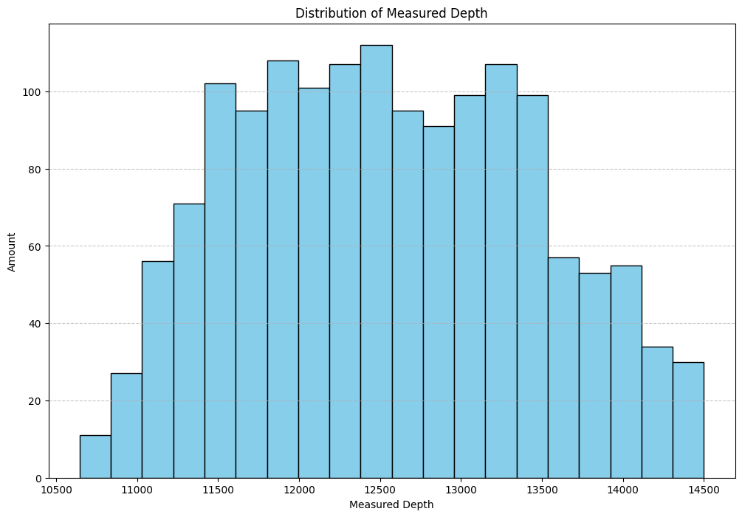
Distribution Analysis:
Histograms:
Distribution of Measured Depth.
Interpretation:
distribution indicating most wells have higher measured depth, while a few have very low rates.

Slide 8
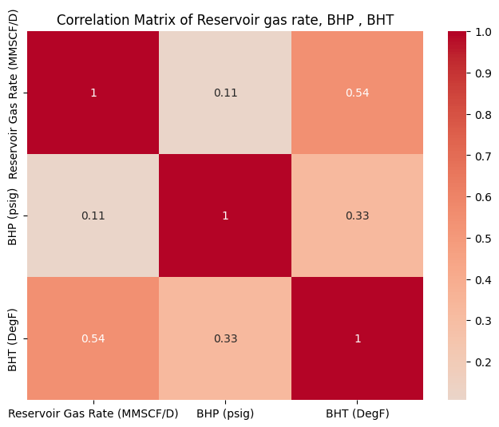
Correlation Analysis:
Heatmap:
Correlation Matrix of Reservoir gas rate, BHP , BHT
Insights:
The Reservoir Gas Rate are not strongly associated with changes in BHP.
There is a moderate positive correlation between the Reservoir Gas Rate and BHT. This indicates that as the Reservoir Gas Rate increases, BHT tends to increase as well, although the relationship is not very strong.
There is a weak to moderate positive correlation between BHP and BHT. This means that there is a slight tendency for BHT to increase as BHP increases.

Slide 9
Well-wise Analysis:
Objective: Identify biozones with the highest gas rate for each well and leg.
Methodology: Grouped the data by well and leg, then identified the biozone with the maximum gas rate.
bio_gas = data.loc[data.groupby(['Well', 'Leg', 'Biozone'])['Gas Rate (MMSCF/D)'].idxmax()]
bio_vs_gas =bio_gas.loc[bio_gas.groupby(['Well', 'Leg'])['Gas Rate (MMSCF/D)'].idxmax()]
bio_vs_gas.reset_index(drop=True, inplace=True)
print(bio_vs_gas)

Slide 10
Key Findings:
Biozones are associated with higher Reservoir Gas Rate (MMSCF/D).

Slide 11
Recommendations:
Focus on specific biozones for maximum gas extraction.
Optimize drilling parameters based on identified patterns.

Slide 12
Project 2: Supply Chain Shipment Analysis
Objective:
To optimize shipment processes and inventory management for better supply chain efficiency
Tools Used:
Python, numpy, pandas, matplotlib, seaborn.
Dataset Overview:
The dataset contains detailed information on Project Code, Country, Fulfill Via, Shipment Mode, Scheduled Delivery Date, Delivered to Client Date, Delivery Recorded Date, Product Group, Sub Classification, Vendor, Item Description, Molecule/Test Type, Brand, Dosage, Dosage Form, Unit of Measure (Per Pack), Line Item Quantity, Line Item Value, Pack Price, Unit Price, Manufacturing Site, First Line Designation, Weight (Kilograms), Freight Cost (USD), Line Item Insurance (USD)

Slide 13
Data Cleaning and Preprocessing:
Handled missing values, converted data types, and filtered relevant columns.
Here are some code snippets for data cleaning
data['Freight Cost (USD)'] = pd.to_numeric(data['Freight Cost (USD)'], errors='coerce')
data['Line Item Value'] = pd.to_numeric(data['Line Item Value'], errors='coerce')
data['Weight (Kilograms)'] = pd.to_numeric(data['Weight (Kilograms)'], errors='coerce')

Slide 14
Exploratory Data Analysis (EDA):
Purpose:
EDA was performed to understand the distribution of data, identify patterns, and detect anomalies.
Key Techniques:
Histograms
Bar plots
Scatter plots
Correlation heatmaps

Slide 15
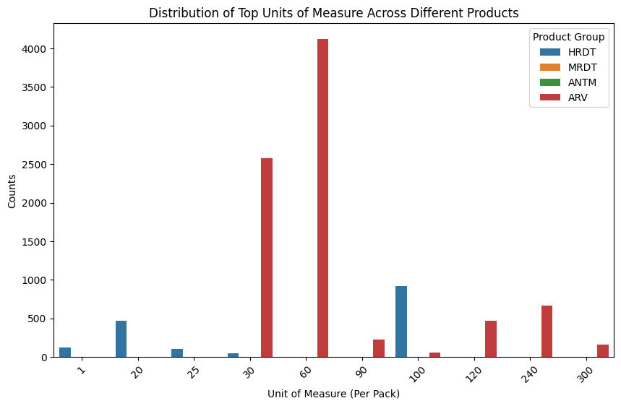
Distribution Analysis:
Bar Plot:
Distribution of Top Units of Measure Across Different Products.
Interpretation:
Distribution is indicating that ARV product has the highest number of product count.

Slide 16
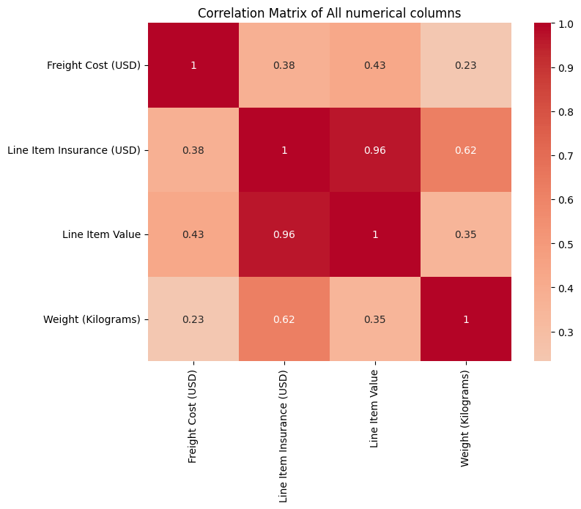
Correlation Analysis:
Heatmap:
Correlation Matrix of all numerical columns
Insights:
A strong positive correlation between Line Item Value and Line Item Insurance(USD), indicating higher Line Item Value will lead higher Line Item Insurance(USD).

Slide 17
Product Group Analysis
Objective: Identify average price and sum of each Product by Line Item Value, Pack Price, Unit Price.
product_group_analysis = data.groupby('Product Group').agg({
'Line Item Value': ['mean', 'sum'],
'Pack Price': ['mean', 'sum'],
'Unit Price': ['mean', 'sum']
}).reset_index()
product_group_analysis.columns = ['Product Group', 'Avg Line Item Value', 'Total Line Item Value', 'Avg Pack Price', 'Total Pack Price', 'Avg Unit Price', 'Total Unit Price']

Slide 18
Key Findings:
Most preferred Shipment Mode is Air.
South Africa is having the highest number of product deliveries.

Slide 19
Recommendation:
Average Unit Price of HRDT product is higher than the other so price optimization should be done.

Slide 20
Conclusion:
The oil and gas analysis provided insights into the most productive biozones and optimal drilling conditions.
The supply chain shipment analysis identified optimal shipment practices.

Slide 21
My Learnings
Throughout my internship at Data Smith AI, I had the opportunity to dive deep into the world of data analytics and gain valuable insights, all while utilizing Python as a powerful tool for analysis. This experience has been transformative, allowing me to develop a solid foundation in data analytics and apply it to real-world scenarios.
Through hands-on projects, I learned various Python libraries, such as Pandas, NumPy, and Matplotlib, which enabled me to efficiently handle and preprocess large datasets. I acquired skills in data cleaning, transformation, and exploratory data analysis, allowing me to uncover patterns, trends, and anomalies within the data.

Slide 22
Thank You

